Slide 1



Configuring QTP
Object Identification
NHS Automation Team

Slide 2
Configuring QTP object identification
QTP object identification
When we record an operation on an object, QuickTest learns a set of properties and values that uniquely describe the object within its parent object.
In most cases, this description is sufficient to enable QuickTest to
identify the object during the run session.
If we expect that the values of the properties in the object description may change frequently, we can configure the way that QuickTest learns and identifies objects.

Slide 3
Different Object Properties Types
QTP object identification
QuickTest has a predefined set of properties that it learns
for each test object.
Mandatory properties are properties that QuickTest always learns for a particular test object class.
Assistive properties are properties that QuickTest learns only if the mandatory properties that QuickTest learns for a particular object in your application are not sufficient to create a unique description.
Ordinal identifier properties The ordinal identifier assigns the object a numerical value that indicates its order relative to other objects with an otherwise identical description

Slide 4
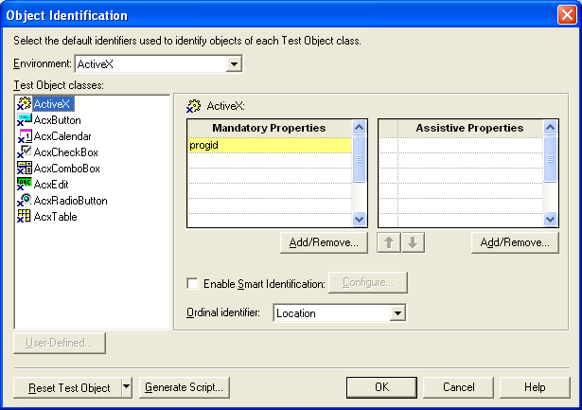
Configuring Mandatory and Assistive Recording Properties
QTP object identification
If we expect that the values of the properties currently used in the object description may change, you can modify the mandatory and assistive properties that QuickTest learns when you record on an object of a given class.
To configure mandatory and assistive properties for a test object class:
1.Choose Tools > Object Identification. The Object Identification dialog box opens.

Slide 5
Configuring Mandatory and Assistive Recording Properties (Contd…)
QTP object identification
Select the appropriate environment in the Environment list. The test object classes associated with the selected environment are displayed in the Test object classes list.
In the Test Object classes list, select the test object class you want to configure.
In the Mandatory Properties list, click Add/Remove. The Add/Remove Properties dialog box for mandatory properties opens.
Select the properties you want to include in the Mandatory Properties list and/or clear the properties you want to remove from the list.

Slide 6
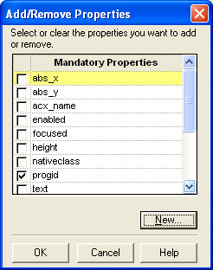
Configuring Mandatory and Assistive Recording Properties (Contd…)
QTP object identification
Click OK to close the Add/Remove Properties dialog box. The updated set of mandatory properties is displayed in the Mandatory Properties list.

Slide 7
Ordinal Identifier
QTP object identification
QuickTest to create a unique description(Ordinal Identifier) when the mandatory and assistive properties are not sufficient to do so.
QuickTest records a value for this backup ordinal identifier only when it cannot create a unique description using all available mandatory and assistive properties.
There are three types of ordinal identifiers that QuickTest can use to identify an object:
Index—Indicates the order in which the object appears in the application code relative to other objects with an otherwise identical description.
Location—Indicates the order in which the object appears within the parent window, frame, or dialog box relative to other objects with a otherwise identical description.
CreationTime (Browser object only)—Indicates the order in which the browser was opened relative to other open browsers with an otherwise identical description.

Slide 8
Configuring Smart Identification
QTP object identification
If QuickTest is unable to find any object that matches the recorded object description, or if it finds more than one object that fits the description, then QuickTest ignores the recorded description, and uses the Smart Identification mechanism to try to identify the object.
The Smart Identification mechanism uses two types of properties:
  Base filter properties—The most fundamental properties of a particular test object class; those whose values cannot be changed without changing the essence of the original object.
  Optional filter properties—Other properties that can help identify objects of a particular class as they are unlikely to change on a regular basis, but which can be ignored if they are no longer applicable.

Slide 9
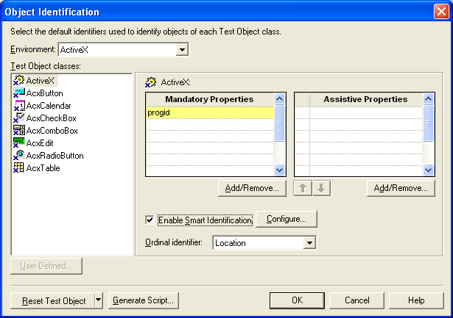
Configuring Smart Identification (Contd…)
QTP object identification
To configure Smart Identification properties:
Choose Tools > Object Identification. The Object Identification dialog box opens.
Select the appropriate environment in the Environment list. The test object classes associated with the selected environment are displayed in the Test object classes list.

Slide 10
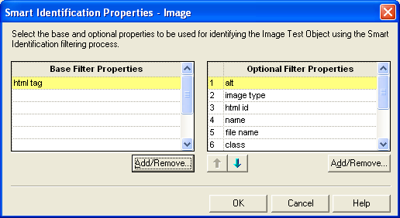
Configuring Smart Identification (Contd…)
QTP object identification
3. Select the test object class you want to configure.
4. Click the Configure button next to the Enable Smart Identification check box. The Configure button is enabled only when the Enable Smart Identification option is selected. The Smart Identification Properties dialog box opens:

Slide 11
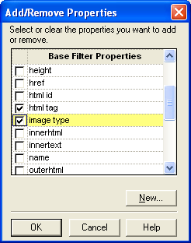
Configuring Smart Identification (Contd…)
QTP object identification
5. In the Base Filter Properties list, click Add/Remove. The Add/Remove Properties dialog box for base filter properties opens.

Slide 12
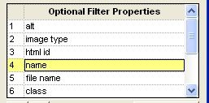
Configuring Smart Identification (Contd…)
QTP object identification
6. Select the properties you want to include in the Base Filter Properties list and/or clear the properties you want to remove from the list.
7. Click OK to close the Add/Remove Properties dialog box. The updated set of base filter properties is displayed in the Base Filter Properties list.
8. In the Optional Filter Properties list, click Add/Remove. The Add/Remove Properties dialog box for optional filter properties opens.
9. Select the properties you want to include in the Optional Filter Properties list and/or clear the properties you want to remove from the list.
10. Click OK to close the Add/Remove Properties
dialog box. The properties are displayed
in the Optional Filter Properties list.

Slide 13
Smart Identification Process
QTP object identification
If QuickTest activates the Smart Identification mechanism during a run session (because it was unable to identify an object based on its learned description), it follows the following process to identify the object:
1. QuickTest "forgets" the learned test object description and creates a new object candidate list containing the objects (within the object's parent object) that match all of the properties defined in the Base Filter Properties list.
QuickTest filters out any object in the object candidate list that does not match the first property listed in the Optional Filter Properties list. The remaining objects become the new object candidate list.

Slide 14
Smart Identification Process
QTP object identification
QuickTest evaluates the new object candidate list:
  If the new object candidate list still has more than one object,
QuickTest uses the new (smaller) object candidate list to repeat
step 2 for the next optional filter property in the list.
  If the new object candidate list is empty, QuickTest ignores this
optional filter property, returns to the previous object candidate list,
and repeats step 2 for the next optional filter property in the list.
  If the object candidate list contains exactly one object, then
QuickTest concludes that it has identified the object and perform
the statement containing the object.

Slide 15
Smart Identification Process
QTP object identification
4. QuickTest continues the process described in steps 2 and 3 until it
either identifies one object, or runs out of optional filter properties to use.
If, after completing the Smart Identification elimination process, QuickTest still cannot identify the object, then QuickTest uses the learned description plus the ordinal identifier to identify the object.
If the combined learned description and ordinal identifier are not sufficient to identify the object, then QuickTest stops the run session and displays a Run Error message.

Slide 16
Summary of the Topics Covered
QTP object identification
Configuring QTP object identification
Different Object Properties Types
Mandatory and Assistive Recording Properties
Ordinal Identifier
Configuring Smart Identification
Smart Identification Process
Questions?

Slide 17

Thank You

